Slide 1


BVRIT HYDERABAD College of Engineering for Women Department of Information Technology
REAL-TIME INTRUSION DETECTION SYSTEM
USING MACHINE LEARNING ALGORITHM
Team- 16
M. Shivani (19WH1A1213)
B. Selvi Reddy (19WH1A1215)
Ch. Shravyasree (19WH1A1227)
J. Shreeya Reddy (19WH1A1234)
Under the Guidance of :
Name: Mr. K. Srikar Goud
Designation: Assistant Professor

Slide 2
CONTENTS
Summary of Stage 1
Architecture
Modules
Functionality
Conclusion
References

Slide 3
Summary of Stage 1
In Stage 1, Slowloris and Synflood attacks dataset is generated using virtual machines like windows, linux-kali.
Tools : 1) Wireshark
2) CICFlowmeter

Slide 4
ARCHITECTURE
- - - - - - - - - - - - - - - - - - - - - - - - - - - - - - - - - - - - - - - - - - -
Training Phase
Training
Dataset
ML Algorithm
- - - - - - - - - - - - -
- - - - - - - - - - - - -
Original
Dataset
Data
Preprocessing
- - - - - - - - - - - - - - - - - - - - - - - - - - - - - - - - - - - - - - - - - - -
- - - - - - - - - - - - - - - - - - - - - - - - - - - - - - - - - - - - - - - - - - -
Testing Phase
Realtime
Dataset
Data
Preprocessing
Testing
Dataset
Trained
ML Model
- - - - - - - - - - - - -
- - - - - - - - - - - - -
- - - - - - - - - - - - - - - - - - - - - - - - - - - - - - - - - - - - - - - - - - -
Benign
Attack

Slide 5
MODULES
Generating Realtime Dataset with attacks
Data Preprocessing
Training with Random Forest Algorithm
Testing the Model with Realtime Dataset

Slide 6
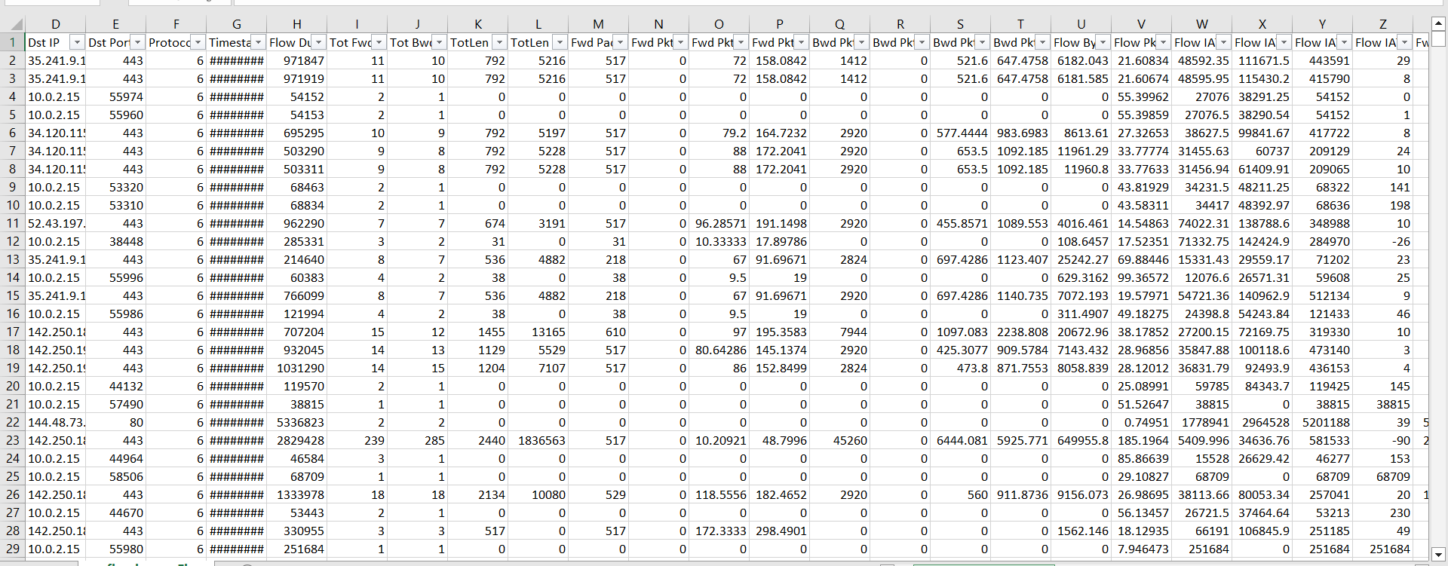
FUNCTIONALITY
Generating Realtime Dataset with attacks

Slide 7
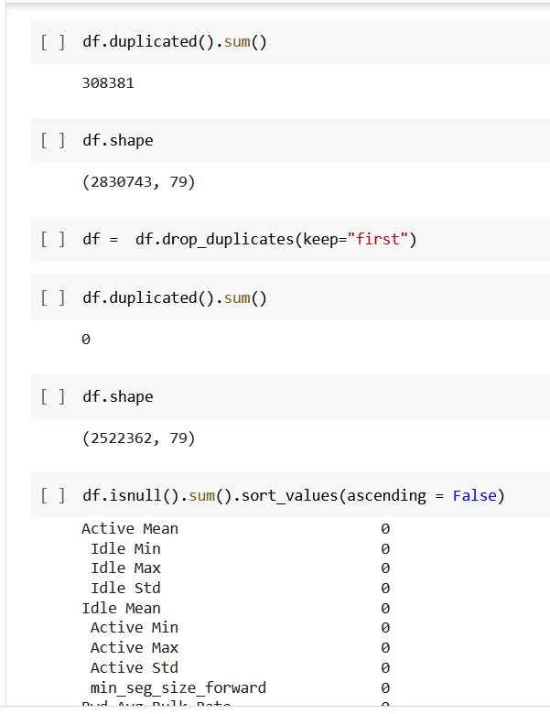
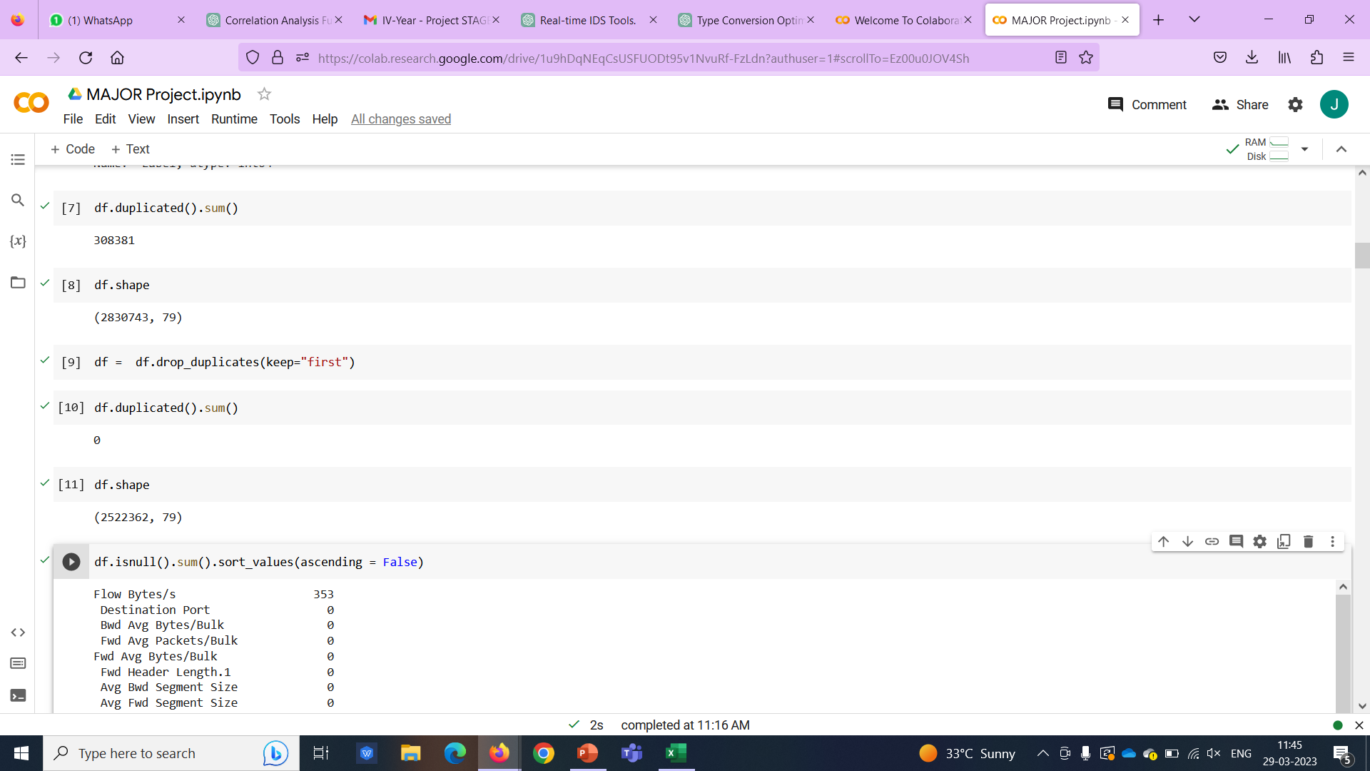
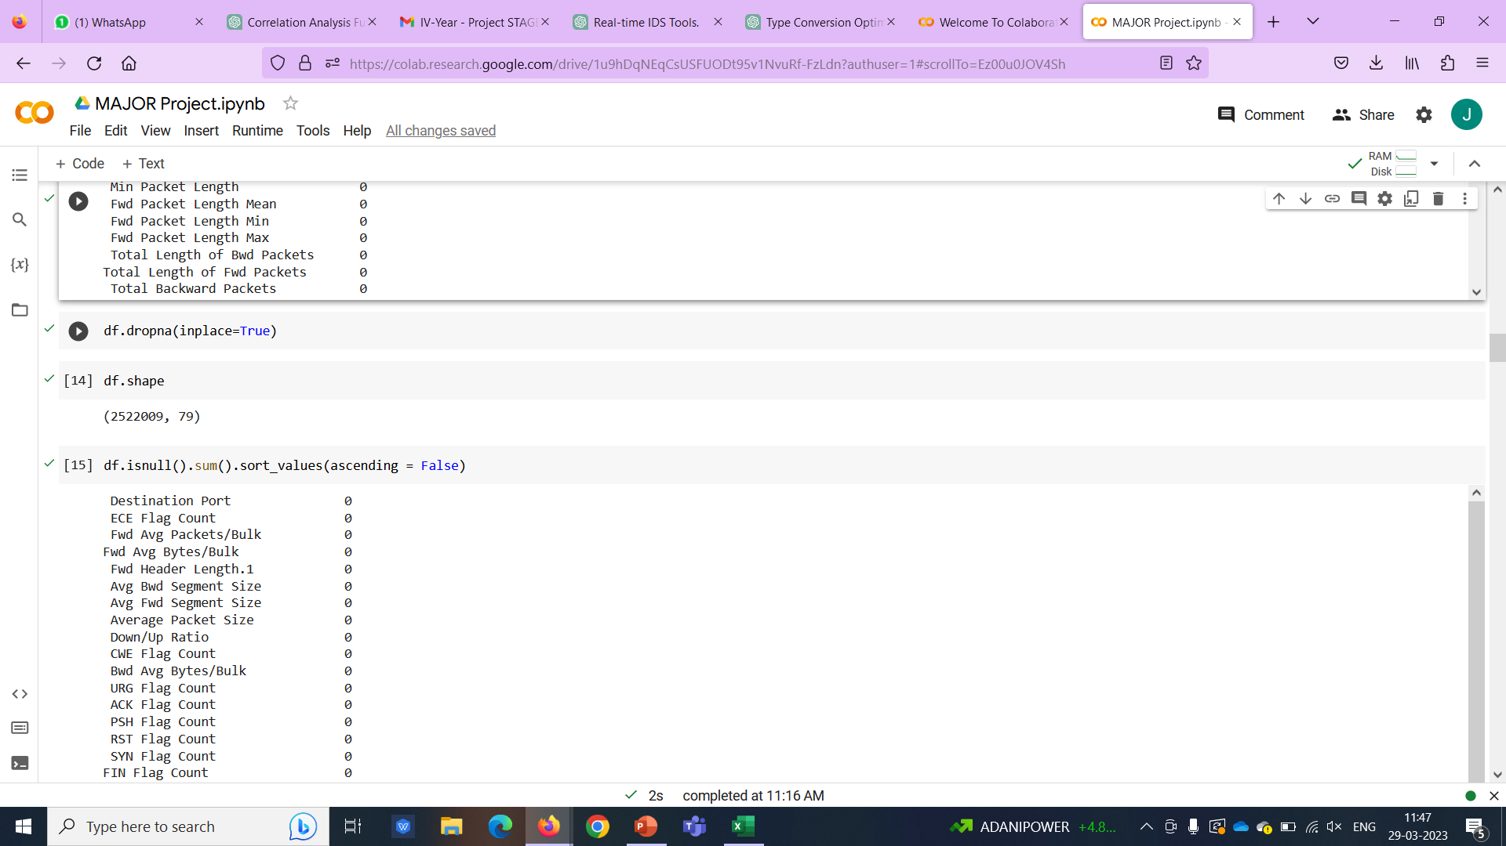
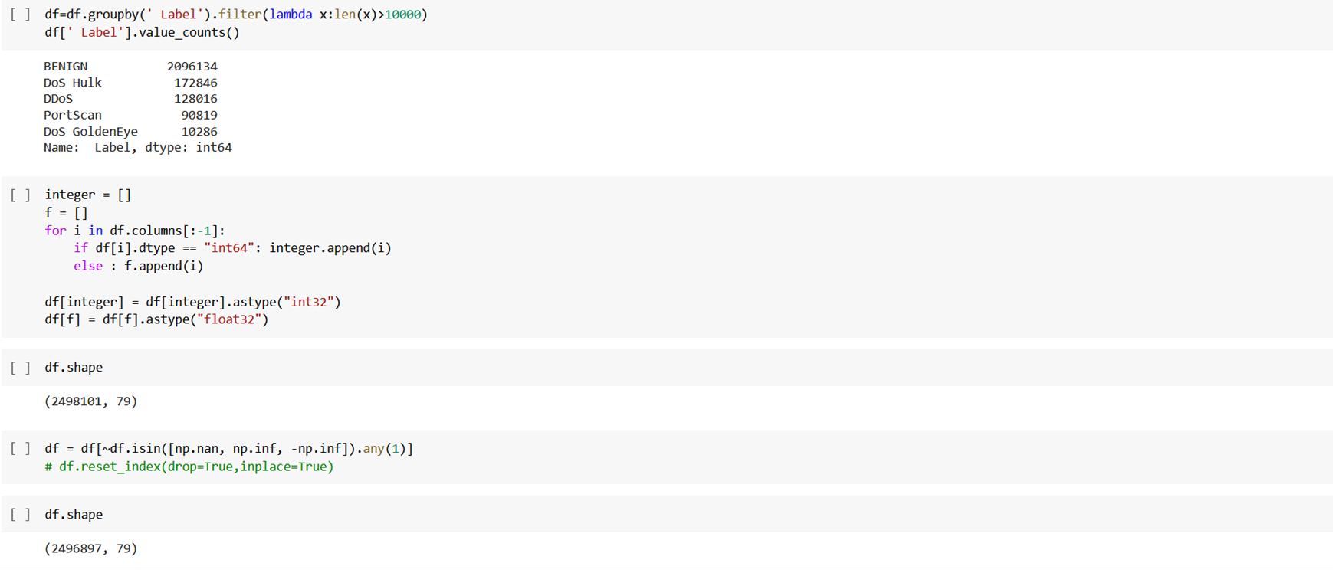
FUNCTIONALITY
Data Preprocessing

Slide 8
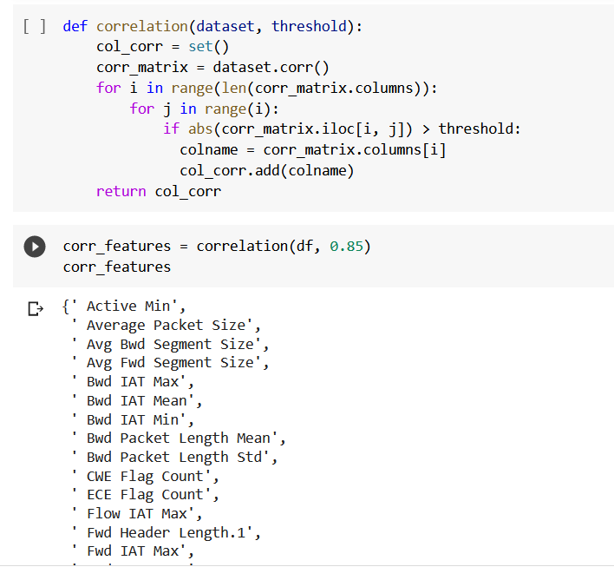
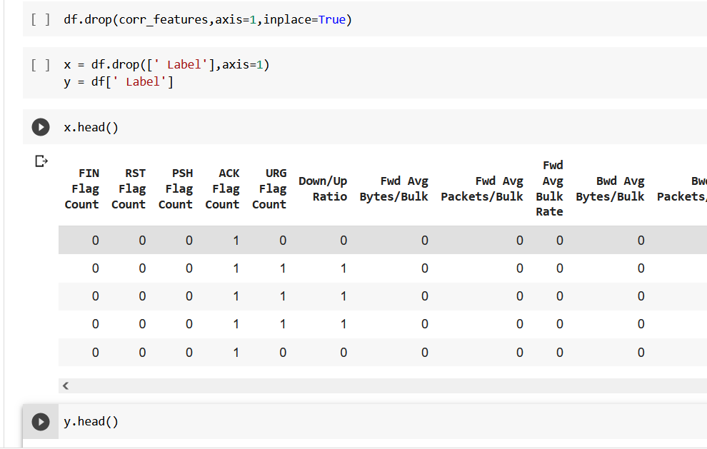
FUNCTIONALITY
Data Preprocessing

Slide 9
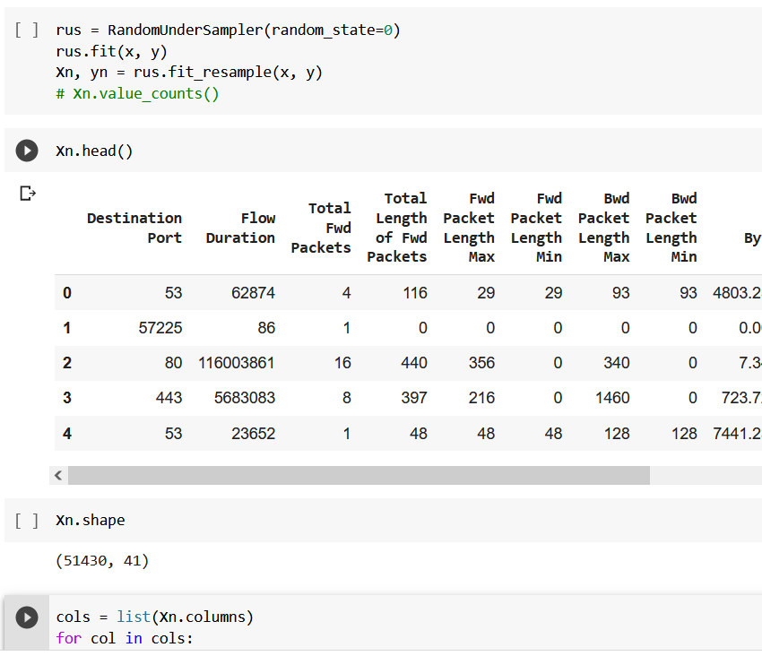
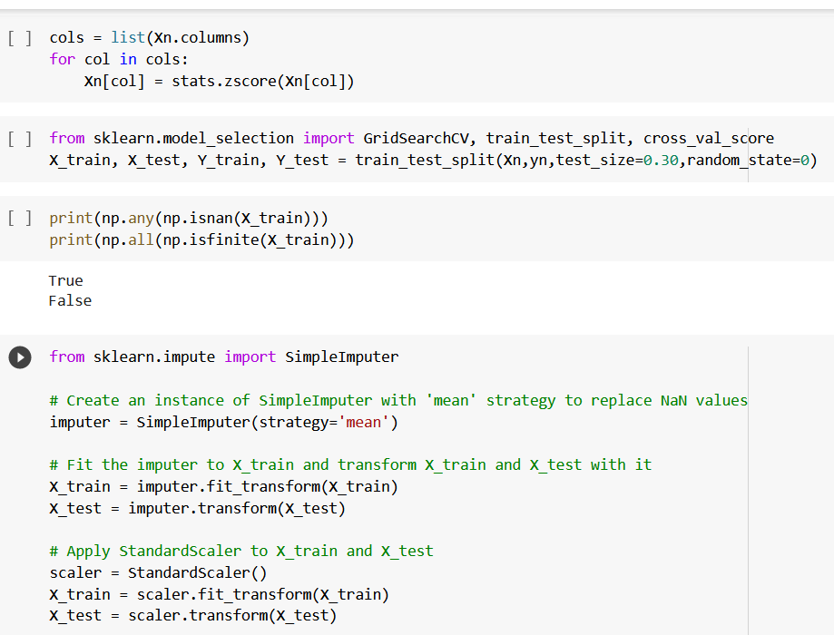
FUNCTIONALITY
Training with Random Forest

Slide 10
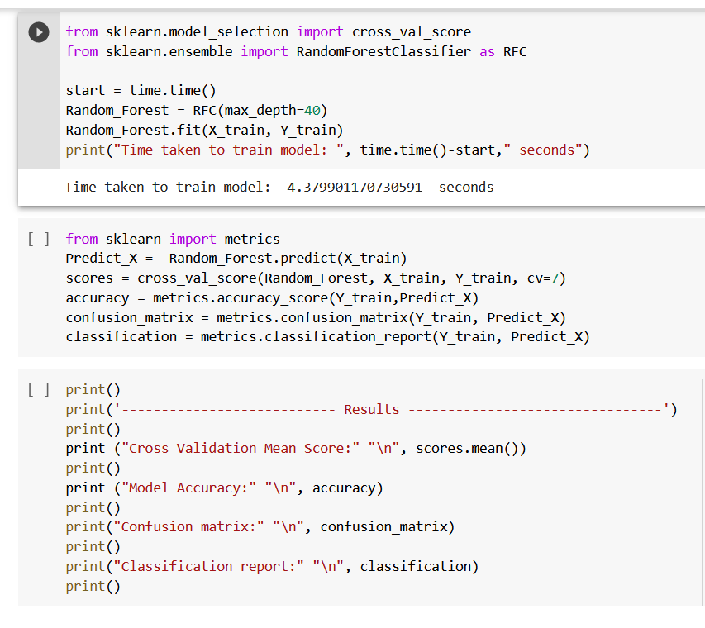
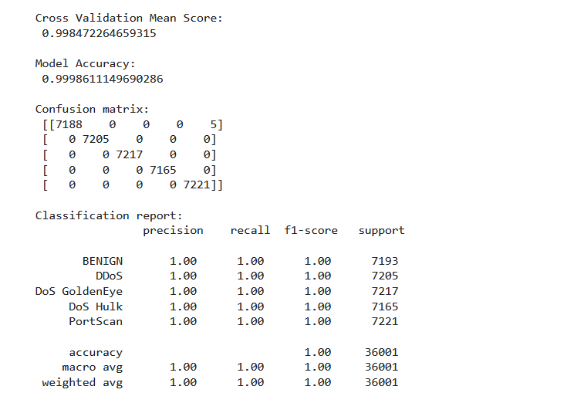
FUNCTIONALITY

Slide 11
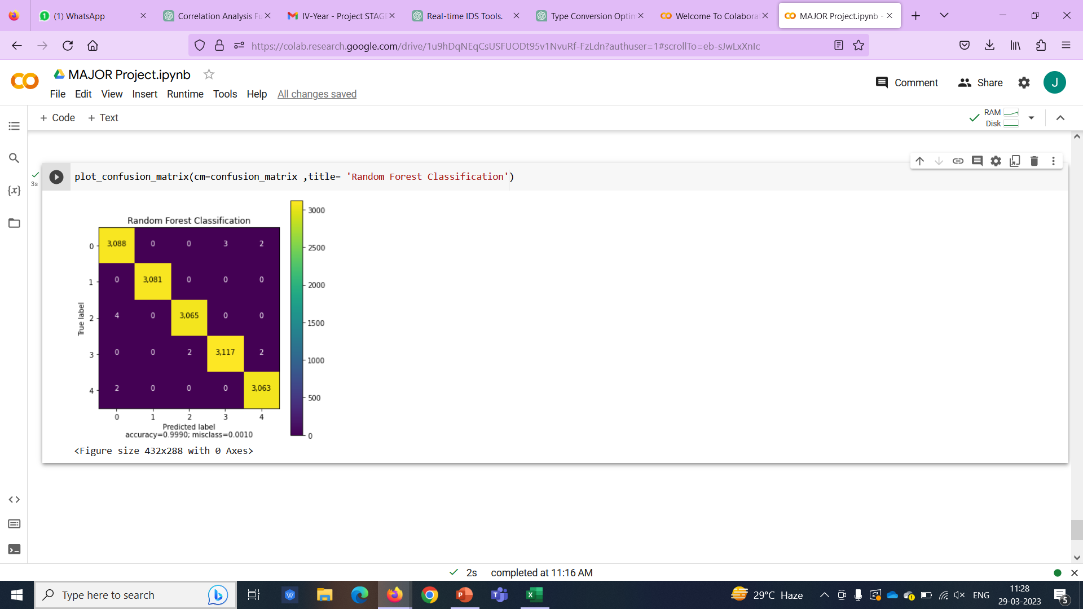
FUNCTIONALITY

Slide 12
CONCLUSION
Intrusion detection system is helpful in detecting what changes are made to the system after an attack.
DDos attack csv file generation, Data Preprocessing, Training ,Building model are done.
Testing will be done in future work.

Slide 13
REFERENCES
[1] Nayak, S., Patil, A.A., Renganathan, R., Lakshmisudha, K. (2021). “Optimizing Network Intrusion Detection Using Machine Learning”. In: Stahlbock, R., Weiss, G.M., Abou-Nasr, M., Yang, CY., Arabnia, H.R., Deligiannidis, L. (eds) Advances in Data Science and Information Engineering.
[2] Naveen Bindra, Manu Sood “Detecting DDoS Attacks Using Machine Learning Techniques and Contemporary Intrusion Detection Dataset”. Aut. Control Comp. Sci. 53, 419–428 (2019).
[3] Dutt, I., Borah, S., Maitra, I.K., Bhowmik, K., Maity, A., Das, S. (2018). “Real-Time Hybrid Intrusion Detection System Using Machine Learning Techniques”. In: Bera, R., Sarkar, S., Chakraborty, S. (eds) Advances in Communication, Devices and Networking .

Slide 14
THANK YOU!!

